Slide 1
Bloodborne Pathogens
Standard 29 CFR Part 1910.1030
Presented by: Barton Insurance Group LLC
© 2005, 2012, 2020 Zywave, Inc. All rights reserved.

Slide 2
Learning Objectives
After this training program, participants will understand:
What bloodborne pathogens are
How infections can occur
What universal precautions are
What to do following an exposure incident

Slide 3
Bloodborne Pathogens: What Are They?
Bloodborne pathogens are microorganisms that are present in human blood and can cause disease to humans.
Common examples include:
The human immunodeficiency virus (HIV)
The hepatitis B virus
The hepatitis C virus

Slide 4
HIV
HIV is a virus that attacks the body’s immune system.
If HIV is not treated, it can lead to AIDS (acquired immunodeficiency syndrome).
Unlike hepatitis, HIV does not live very long outside the human body.
There is currently no effective cure for HIV. Once people get HIV, they have it for life.

Slide 5
Hepatitis B
Hepatitis B is inflammation of the liver. When the liver is inflamed or damaged, its function can be affected.
Symptoms include jaundice, fatigue, abdominal pain, loss of appetite, nausea and vomiting.
Hepatitis B can lead to chronic liver disease, liver cancer and death.

Slide 6
Hepatitis C
Hepatitis C is a liver infection caused by the hepatitis C virus.
Hepatitis C can range from a mild illness lasting a few weeks to a serious, lifelong illness.
Hepatitis C is usually spread when blood from a person infected with the hepatitis C virus enters the body of someone who is not infected.
People with new (acute) hepatitis C virus infection usually have mild symptoms or no symptoms at all.

Slide 7
What Is the Risk?
Even if employees don’t work with blood and other bodily fluids, there can be exposure at work for employees who:
Administer first aid
Clean up blood after an injury

Slide 8
What’s an Exposure Incident?
Examples of an exposure incident involving bloodborne pathogens include:
Infected blood comes in contact with broken skin.
Infected blood comes in contact with a mucous membrane (e.g., the eyes, nose or mouth).
The purpose of this training is to prevent exposure incidents from happening.

Slide 9
Universal Precautions
We can not tell by looking at any individual whether he or she is infected with a bloodborne pathogen. Because of this, we must treat all blood and other body fluids as if they were infected. This approach is called universal precautions.
We must always wear the required personal protective equipment (PPE) and take the appropriate cleaning and sanitation steps to prevent exposure to ourselves and to others.
Again, taking universal precautions means treating all blood and bodily fluids as if they’re infected.

Slide 10
Preventing Exposure Incidents
Always wear the required level of PPE when responding.
Clean and sanitize any surfaces that were in contact with blood or other body fluid.
Carefully remove and discard PPE.
Wash your hands with large quantities of soap and warm water immediately.
All persons trained and authorized to respond to incidents are eligible to receive the hepatitis B vaccine.

Slide 11
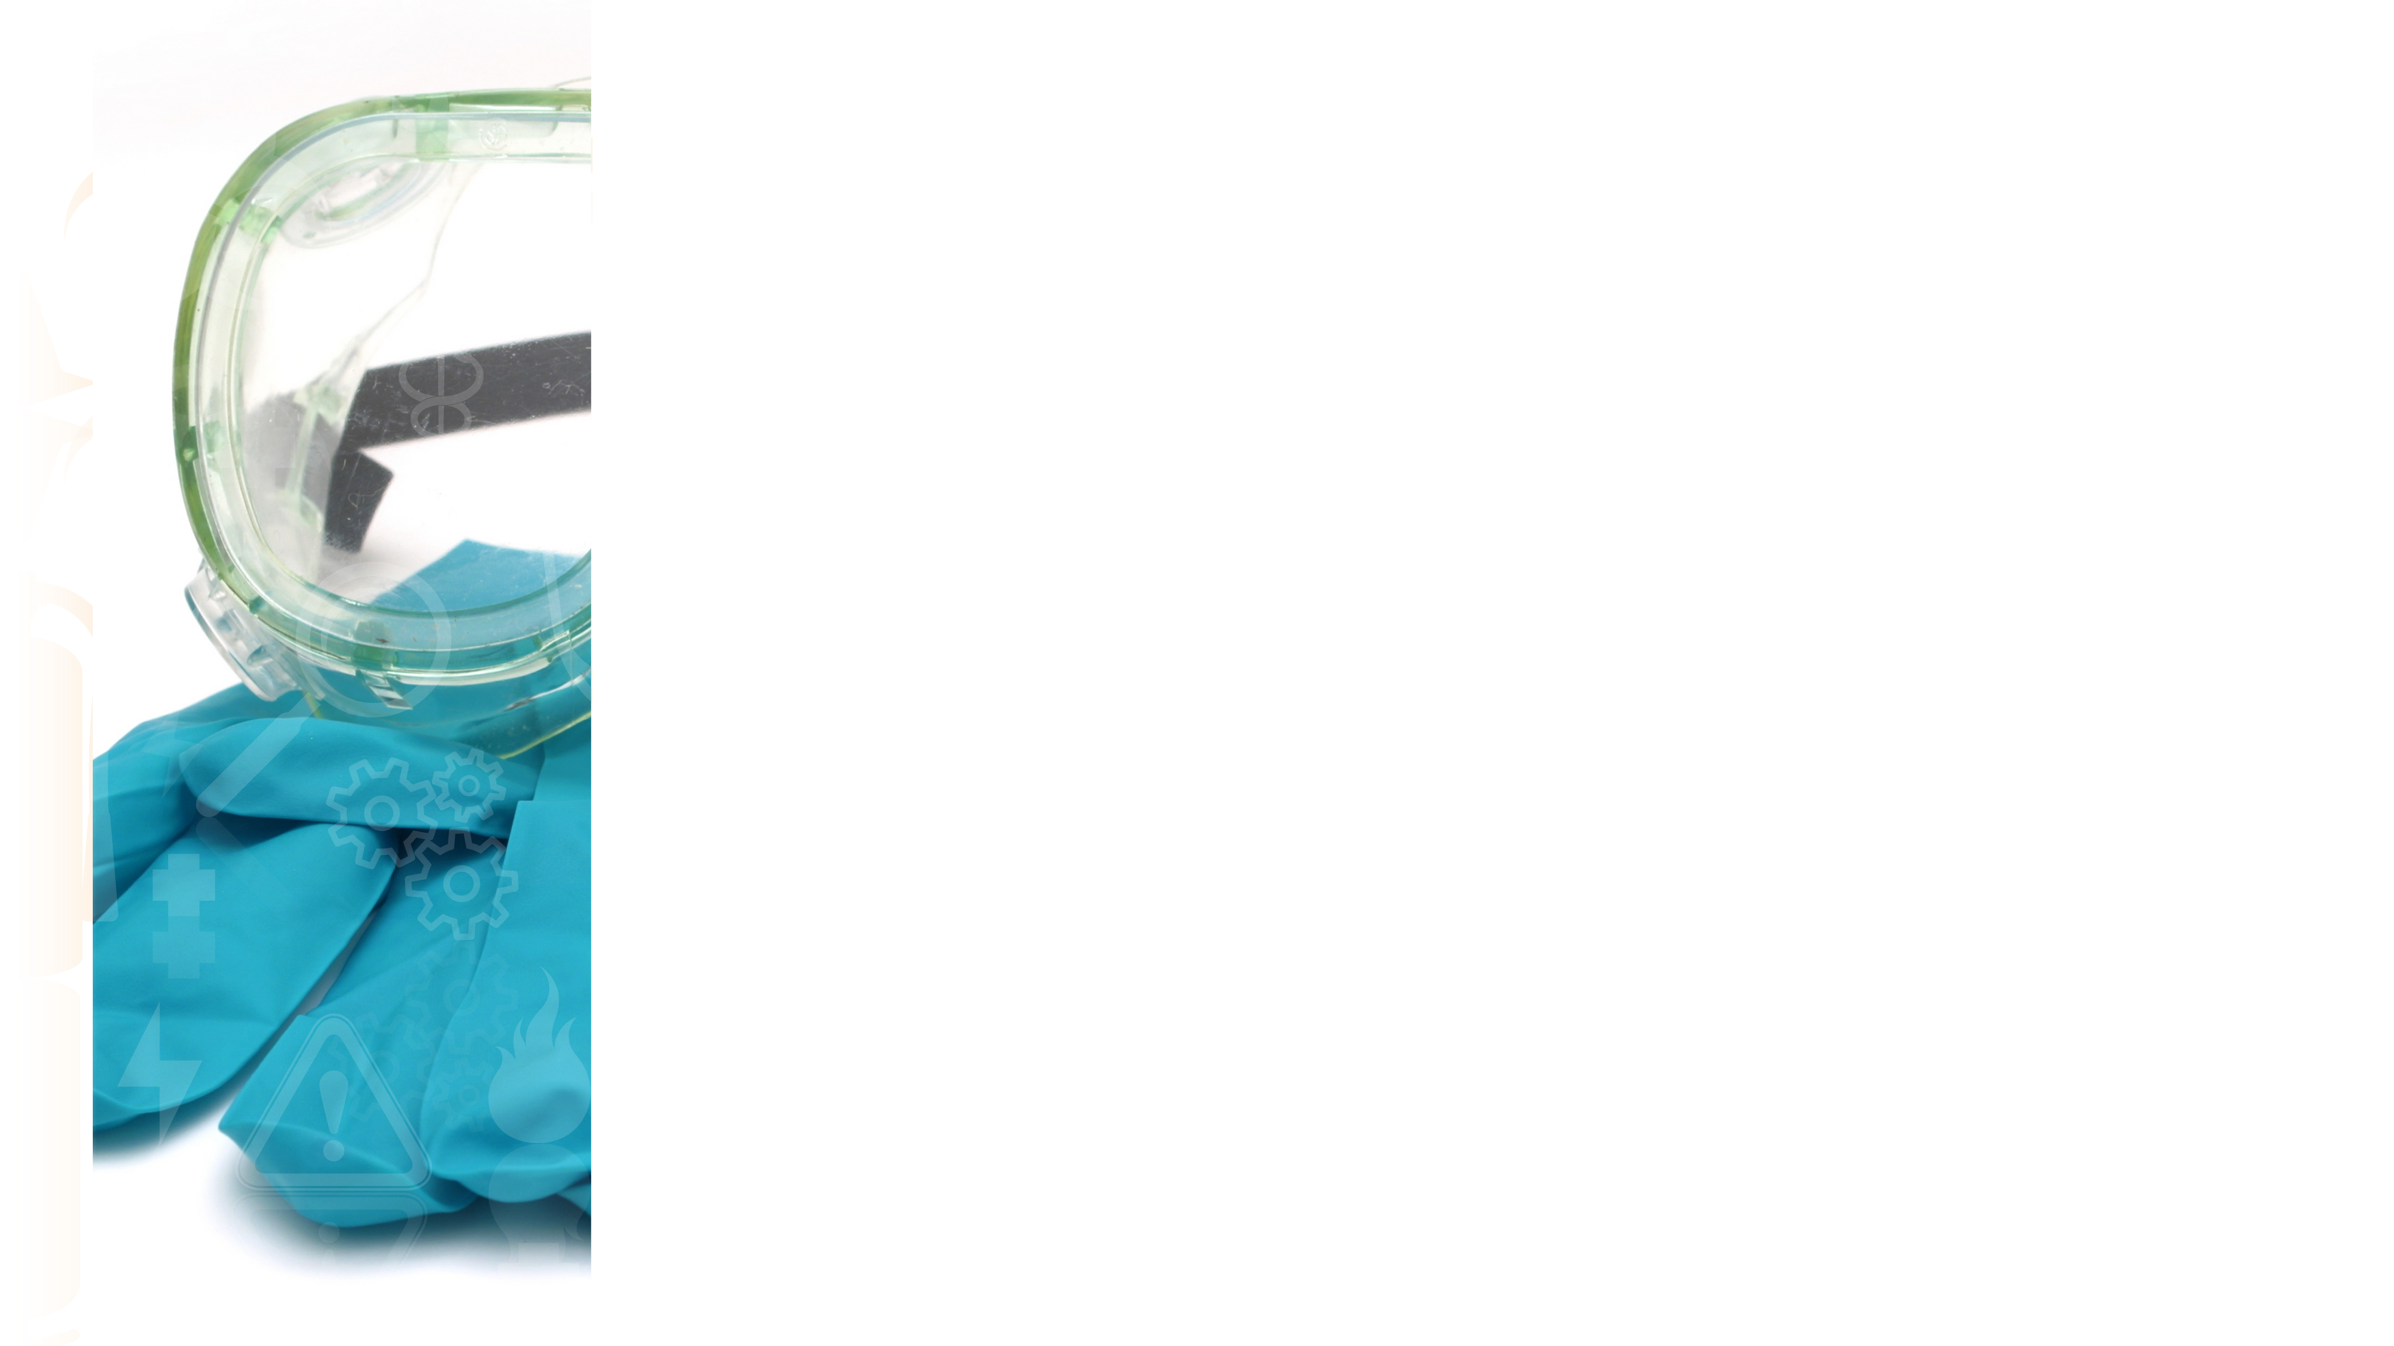
PPE
Safety glasses with side shields: Required for all bloodborne pathogen responses.
Face shield: Use if blood or other fluid could splash, spray or become airborne.
Disposable gloves: Required for all bloodborne pathogen responses (double gloving is always recommended).
Apron/disposable suit and shoe covers: Use if blood or other fluid could splash, spray or become airborne, or otherwise come in contact with the feet and body.
Barrier mask/bag valve mask: For CPR or mouth to mouth/nose/stoma breathing.

Slide 12
Cleanup and Sanitation
Wear all required PPE.
Treat all spills, bandages and similar incidents with an approved bloodborne pathogen cleanup solution. It should be noted that OSHA allows the use of bleach solutions, so long as they are diluted to 1:10.
Any material that has the potential to liberate liquid blood and/or dust when dried should be placed in a red biohazard bag, and that bag should be re-bagged (double bagged). Red biohazard bags must be properly disposed of.
Wipe up the surfaces that were in contact with the spill using the sanitizer.

Slide 13
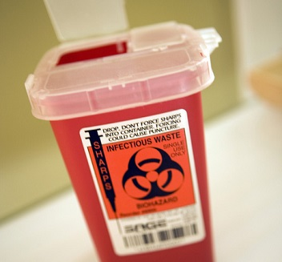
Sharps
Contaminated needles or other sharps pose a bloodborne pathogen risk, as they may penetrate the skin.
Sharps must be properly disposed of in an approved container.
Needle sticks must be reported as other exposure incidents.

Slide 14
What to Do When Exposed
If another person’s blood or body fluid comes into contact with your skin or mucous membranes (e.g., the eyes, nose or mouth), follow these steps:
Wash skin with large amounts of soap and warm water.
Flush mucus membranes with large quantities of warm water.
Report the incident to your supervisor or program administrator.
Follow instructions. You will be provided with follow-up, confidential care (paid for by our facility).

Slide 15
Hepatitis B Vaccine
The hepatitis B vaccine is offered to all employees who have potentially been exposed.
The vaccine is provided at no cost to the employee.
If the employee doesn’t want the vaccine, they must sign a declination form, which will be kept on file.
It should be noted that there are no vaccines for HIV or hepatitis C.

Slide 16
Summary
Unprotected contact with blood contaminated with bloodborne pathogens can transmit disease through contact with the eyes, nose and mouth, as well as with broken skin.
Observe universal precautions: Always treat blood and other body fluids as if they are contaminated.
Wear all necessary PPE.
Clean and sanitize any spill area with sanitizer.
Report any suspected exposure incident.

Slide 17
For More Information
For more information regarding bloodborne pathogens or other safety issues, please contact:
Barton Insurance Group LLC
www.bartoninsurancegroupllc.com
615.806.1265

